Slide 1
Inclined Planes adapted from Brain Pop

Slide 2
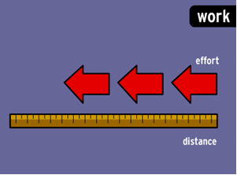
Inclined Planes
An inclined plane makes work easier. To understand this, we need to understand the concept of work. Work is the effort extended over a certain distance.

Slide 3
3. In the picture below, Moby could by
bypass the ramp and jump straight up onto the platform. It would take the same amount of work, but would require short burst of energy.
Tired Moby!

Slide 4
4. An inclined plane increases the distance that Moby exerts force, but decreases his effort 5. The effort is spread out over a greater distance so Moby can move more boxes with less effort.

Slide 5
6. So if you increase the __ __ __ __ __ __ __ __ , you
decrease the effort.
So if you increase the distance, you decrease the effort!

Slide 6
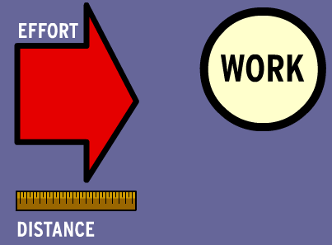
7. If you decrease the distance,
you increase the effort, but the amount of
work always remains constant.

Slide 7
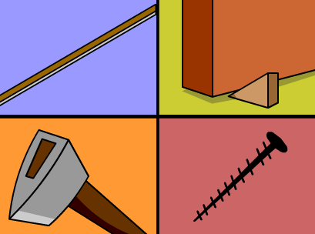
You can find inclined planes everywhere:
Ramps, door stoppers, and even axes!
9. Screws are really just a long inclined plane wrapped around a piece of metal.

